Slide 1
Force, Work, Energy
Crazy for fyziks xd

Slide 2
Review last week? Jk. . . unless. . .

Slide 3
Force. . . and this Newton kid

Slide 4
Newton’s 3 laws of motion (things do be moving)
Inertia: An object in motion will stay in motion and an object at rest will stay at rest unless acted upon by an outside force.
Force = mass * acceleration
Force pairs: For every action, there is an equal and opposite reaction.

Slide 5
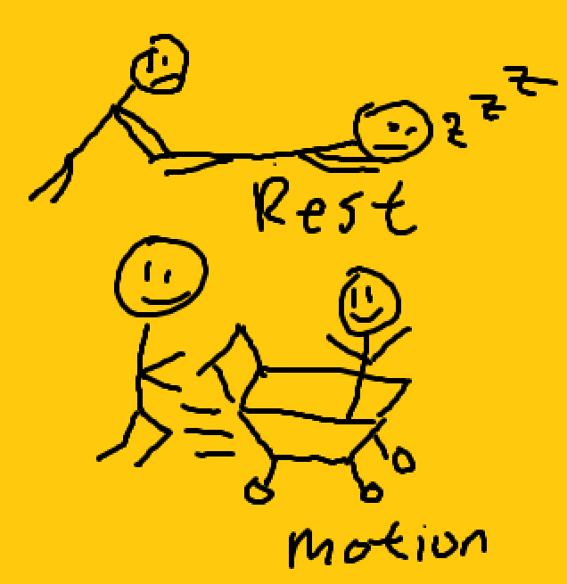
Inertia is a property of matter
If we push a shopping cart it wants to keep going forward (goes whee!!!)
If we’re sliding on a floor, we want to keep sliding
If we’re not moving, we don’t suddenly move unless we push ourselves

Slide 6
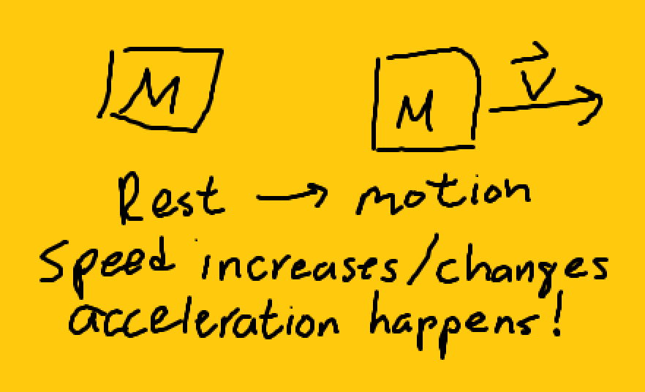
F = ma (this is the important slide)
Forces “push” on objects
Mass is how much matter is in something
Acceleration is change in speed divided by time
Force is dependant on these two things; why?

Slide 7
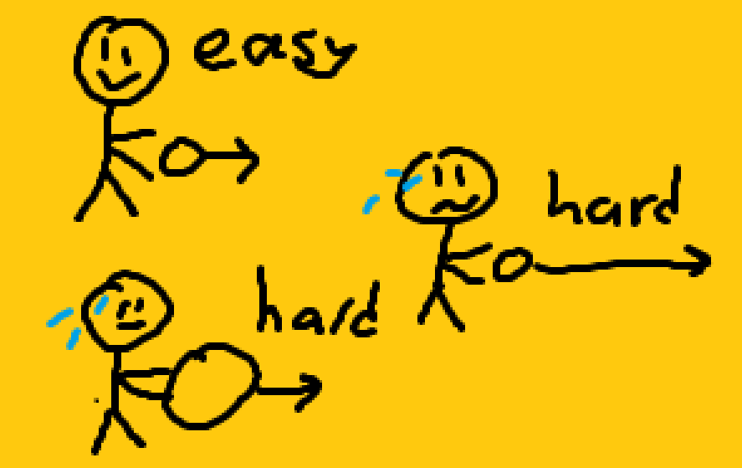
But why is F = ma?
An object that has more mass is harder to “push”
It’s harder to “push” an object faster (change its speed/velocity more), which means it’s harder to accelerate objects more
Thus, if we have more mass and/or acceleration, force is higher!

Slide 8
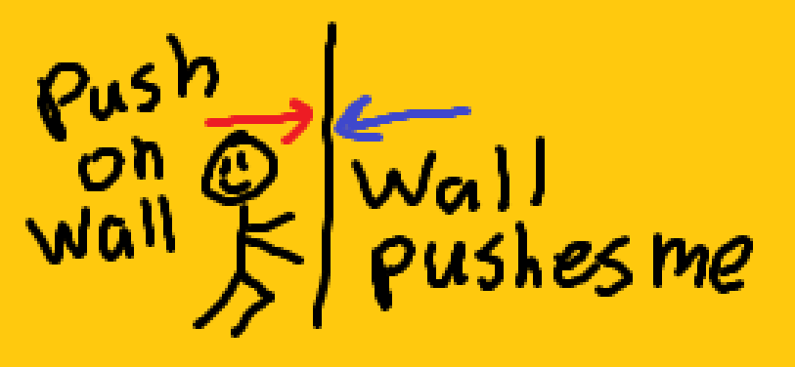
Force pairs
If I push on an object, that object pushes back on me with the same force
Question to think about: if my car runs into a fly, and I squash the car, why doesn’t the fly break my windshield if it applies the same force? Hint: think 2nd law. . .

Slide 9
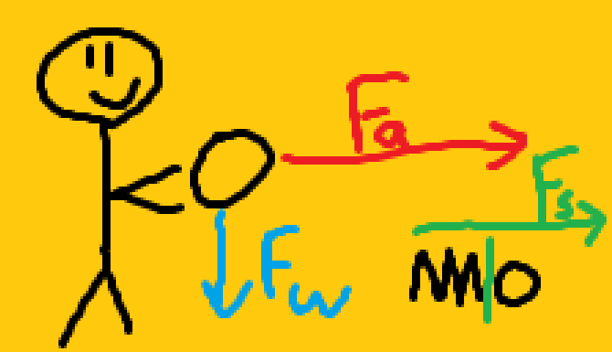
Important forces?
Me pushing a ball to get it to move
Gravity!!!
Springs?

Slide 10
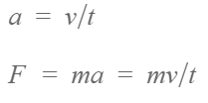
Units/symbols/equations
Force (F): Newtons (N)
Mass (m): kilograms (kg)
Acceleration (a): meters per second squared (m/s^2)
Velocity (v): meters per second (m/s)
Time (t): seconds (s)

Slide 11
What is work?

Slide 12
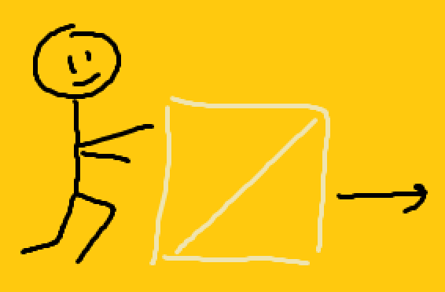
Times we do work
Pushing a box
Lifting a book
Kicking a ball
Pushing on a spring
“Pushing” something a certain distance takes work

Slide 13
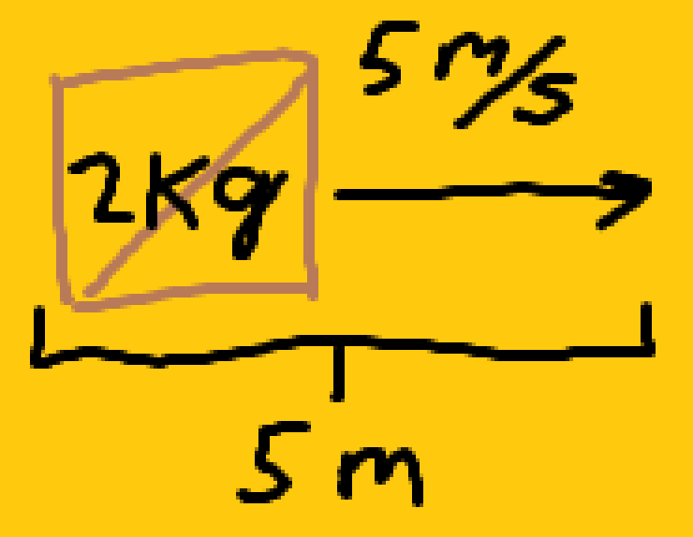
Work = Force * Distance (W = F * d)
Sample problem lulw:
What is the acceleration of a 2 kg box if I pushed it from rest to 5 m/s in 1 second?
What is the force on the box?
If I pushed it 5 meters, how much work did I do on it?

Slide 14
Energy

Slide 15
What is energy?
Energy is the “ability to do work,” measured in Joules (J = N * m)
A box I lifted up can do work when gravity pushes down on it
Friction can slow down a stapler I slide across the table
A spring can push on something if I compress it

Slide 16
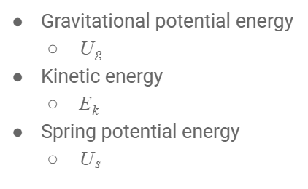
Types of energy
A box I lifted up can do work when gravity pushes down on it
Friction can slow down a stapler I slide across the table
A spring can push on something if I compress it

Slide 17
Prepare for the xd

Slide 18

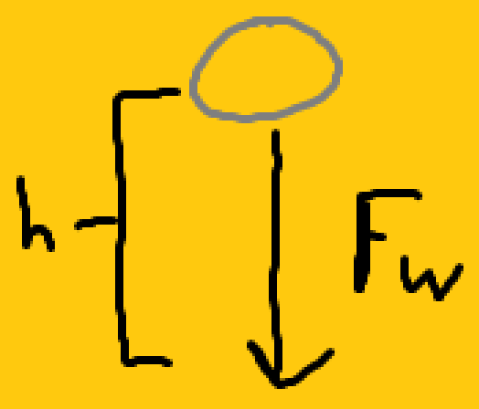
Gravitational potential energy
“Weight” is a force that’s the mass of the object times the acceleration due to gravity (g)
Gravitational potential energy is the “ability” for gravity to do work over distance

Slide 19

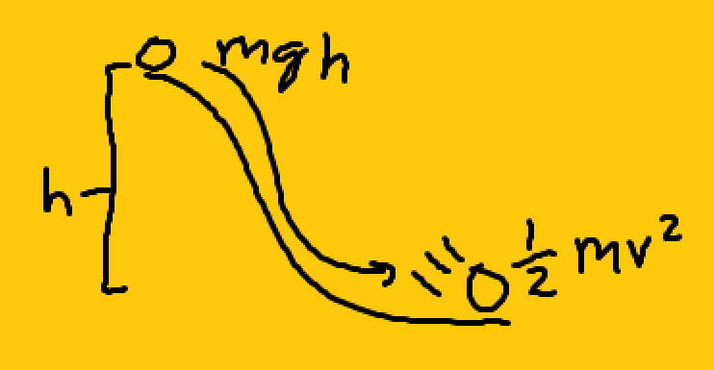
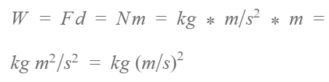
Kinetic energy, kind of spoopy
Kinetic energy is ½ mass * velocity squared
But why? The proof is hard lulw, but let’s look at the units

Slide 20
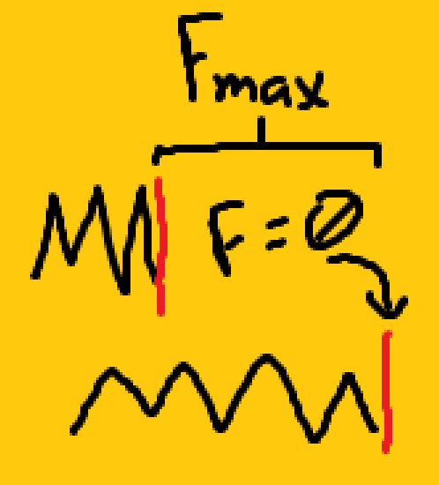
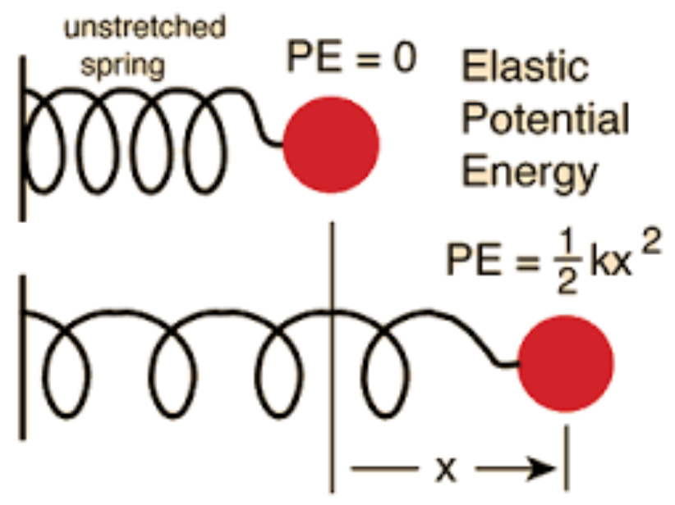
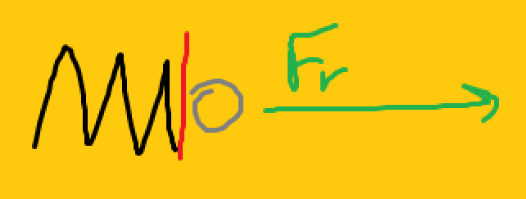

Spring potential, the super, super yummy one
The force changes as the spring decompresses. One can consider the “average” force on the spring, which is half of the force when the spring is totally compressed.

Slide 21
Scary over, now you may perform respiratory actions at a pace you deem acceptable

Slide 22
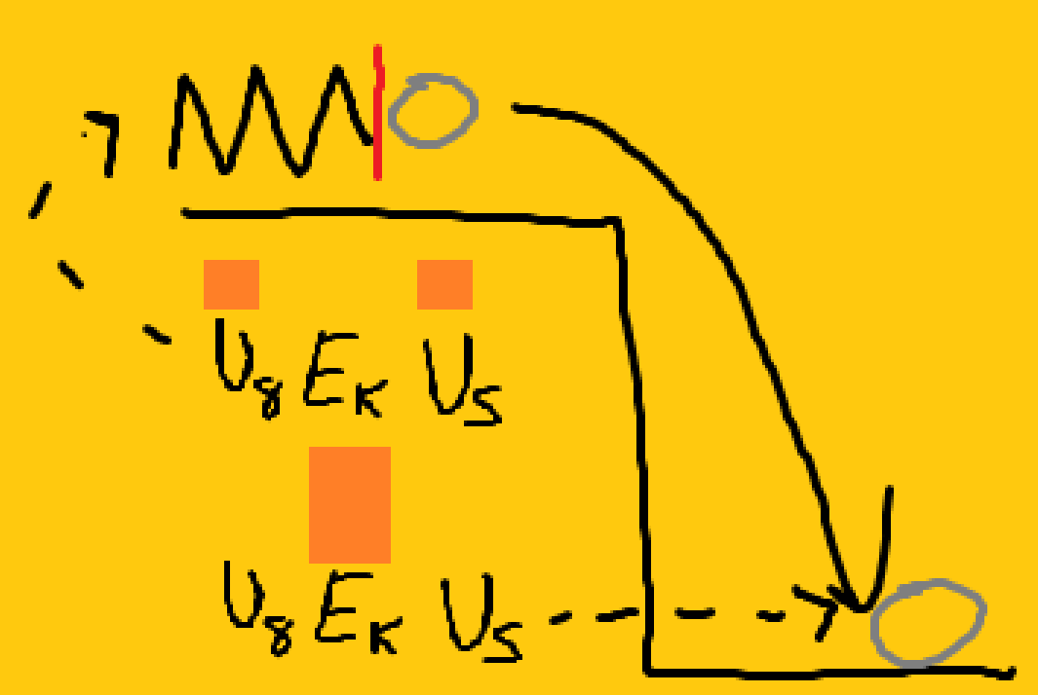
Energy is conserved
The “Total Mechanical Energy” (TME) is the sum of the three energies we just talked about. This TME never changes.

Slide 23
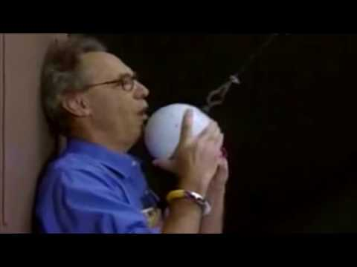
Conservation of energy

Slide 24

Conceptual review (hard)
If I drop a ball that has 20 J of potential energy onto a spring, what energy will the ball have when it fully compresses the spring?
In the picture on the right, what kinds of energies does the roller coaster have?

Slide 25
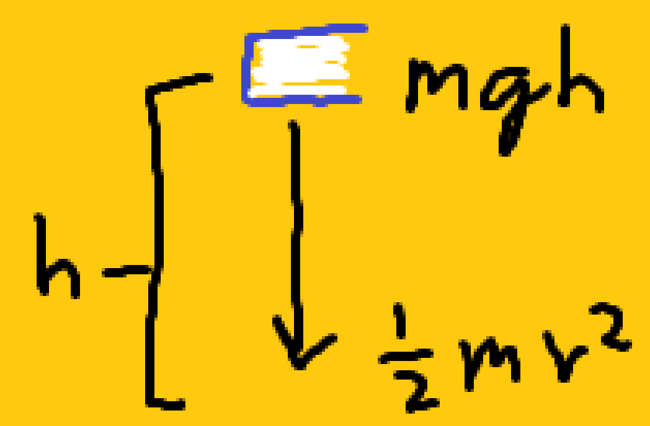
Math review (very fun)
How much potential energy does a 2 kg book have if I hold it 3 meters up assuming acceleration due to gravity (g) is 10 m/s^2?
If I drop that book, how much kinetic energy will it have when it hits the ground?
What’ll be its speed when it hits the ground?

